Slide 1

Coursera Capstone Project
Battle of Chinese Restaurants

Slide 2
Introduction
New York City is one of the most ethnically diverse cities in the work, with expats being around 40% of the population in it.
With a huge percentage of expats, there are a lot of restaurants with international cuisines. Middle eastern food, Indian food, Chinese food. It is always nice to find your own home country’s food in a foreign country to remind you of where you grew up.
With that being said, our project will be to help people who want to open their own international restaurant to attract expats or others who like to try new cuisines.

Slide 3
Problem
You have the money and the means to open your own business, you decide to open a Chinese restaurant in New York city. The question is, if you were to open a Chinese restaurant, where should it be? you probably don’t want any competition. Let’s find out

Slide 4
Interest
People who would like to have fewer competitions for their restaurants, so that more customers would come to them (taking into account the food is great of course)

Slide 5
Data
The Data that we will be using for this project consists of two things:
New York City data that contains list Boroughs, Neighborhoods along with their latitude and longitude. This data set contains the required information. This data set will be used to explore various neighborhoods of new york city. Data source: https://cocl.us/new_york_dataset.
Chinese restaurants in each neighborhood of new york city. We will get all the Chinese restaurants in the list of neighborhoods of new york city using Foursquare API.

Slide 6
Methodology
Get New York City data from https://cocl.us/new_york_dataset
Find all Chinese Restaurants in each of the neighborhoods using FourSquare API
Choose the neighborhoods or Boroughs with the least Chinese restaurants as potential candidates

Slide 7
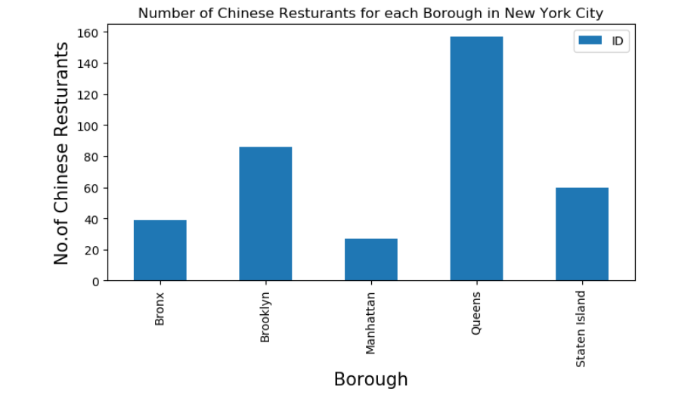
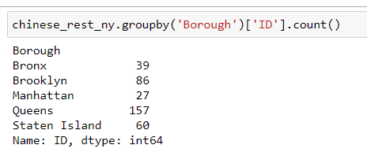
Analysis
Using our tools to analyze the data we got to know that the least Borough with Chinese restaurants would be Manhattan as shown in the chart.

Slide 8
Conclusion
If you are trying to open a Chinese restaurant, our advice is to open it in Manhattan, as you will have less competition there.

